Slide 1
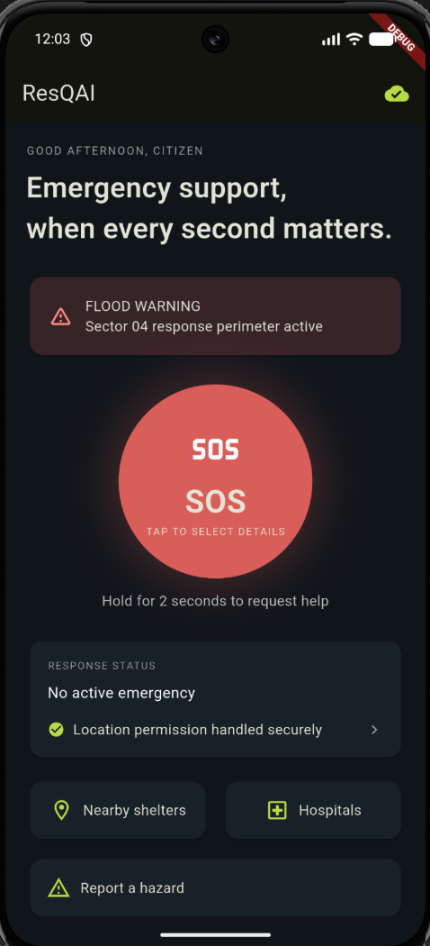
ResQAI – Intelligent Disaster Response Citizen Application
COLLEGE PROJECT REVIEW
Connecting Citizens with Smarter Emergency Workflows.
Student: SAISANJAY SS - 240701458
BALAJI S - 240701069
Department: Computer Science and Engineering
College: Rajalakshmi Engineering College
Project guide: [Mrs B.Deepa
Assistant Professor( SG)
Notes:
Introduce yourself, the project title and guide. Replace the bracketed placeholders (name, register number, college, guide) before presenting. The phone graphic is a concept illustration, not an app screenshot.

Slide 2



1. INTRODUCTION
Disaster response
Citizen challenges
Why mobile?
Coordinated actions to protect people before, during and after an emergency.
Panic and stress, unclear next steps, difficulty sharing an exact location, scattered information.
Phones are always carried, location-aware and able to send notifications and media.
Project objectives
The problem
Scattered, slow, uncertain emergency actions
1
Provide a simple emergency-related mobile interface
2
Support an SOS workflow
3
Support location access with user permission
The proposed solution
ResQAI: one mobile interface for SOS, location and incident details
4
Help users prepare incident information
5
Provide a foundation for future disaster-response integration
Notes:
Define disaster response, list the typical citizen problems, then explain why a mobile app helps. Finish with the five objectives.

Slide 3




2. LITERATURE REVIEW
Mobile applications in disaster management
Existing Technology | Main Purpose | Relevance to ResQAI
Mobile Applications | Access to digital services | Central user interface
Location Services | Identify geographical position | Supports location information
Incident Reporting | Record event details | Organizes incident information
Notifications | Communicate updates | Potential future alert support
Phones as the main citizen access point
Location-based services and GPS
Position data to support response
Incident reporting and image sharing
Structured details and visual evidence
Notifications and digital communication
Timely updates to users
Usability, connectivity, privacy, reliability
Key design constraints in emergencies
Project motivation: combine emergency-related workflows and location information in one mobile interface.
Conceptual review of technology areas; no formal systematic literature survey was conducted.
Notes:
This is a conceptual overview of the technology areas behind the project. It is not a formal systematic literature survey and does not cite specific research papers.

Slide 4


3. PROPOSED SYSTEM
Citizen mobile interface
SOS and emergency workflow
BEFORE
Emergency information and actions may be spread across different tools.
Dark, high-contrast Flutter UI designed for stressful moments
SOS button with emergency type, headcount and medical details
Location access
Incident information and media
PROPOSED
A unified interface for supported emergency-related workflows.
Uses device location with user permission
Hazard-report entry; image selection where implemented
Navigation and state
Future backend integration
GoRouter screens with Riverpod-managed state
Secure backend and authorized services (planned)
Live emergency-service integration is a future requirement unless verified in the implementation.
Notes:
Contrast the before and proposed situations. Be explicit that ResQAI is not claimed to be connected to police, ambulance, fire or government systems.

Slide 5
3.1 ARCHITECTURE DIAGRAM
Citizen / User
How data moves
ResQAI Mobile Application – Flutter and Dart
1
The user acts on the interface (e.g. SOS, report).
Application Interface and Navigation
2
GoRouter opens the screen; Riverpod providers hold shared state.
SOS Workflow
Location Access
Incident Reporting
3
Modules request location (Geolocator) or media (image picker) with permission.
Riverpod
State Management
GoRouter
Navigation
Geolocator
Location
Dio
Network Communication
Media Selection
and Local Storage
4
Dio is the HTTP layer for sending data to a backend – future integration.
Future Backend and Authorized Emergency Services
FUTURE INTEGRATION – not claimed as implemented
Notes:
Walk top to bottom: user, Flutter app, navigation layer, three functional areas, supporting packages. The amber dashed box is future work only; no live connection to emergency services is claimed.

Slide 6
4. MODULES DESCRIPTION
4.1 MODULE 1 – SOS AND EMERGENCY WORKFLOW
4.2 MODULE 2 – LOCATION AND INCIDENT REPORTING
Entry point for emergency-related actions
Guides the user through the supported workflow
May request relevant information, such as location
Clear validation and error messages
Does not claim an alert was delivered without confirmation
Uses location services with permission
Supports preparing incident descriptions
Supports selecting images, if implemented
Can be extended to submit reports via a backend
Handles denied permissions and unavailable location data
Seen in the UI: emergency-type chips (Flood, Fire, Medical, Accident, Building Collapse, Other), people count, medical-assistance toggle, Confirm SOS.
Seen in the UI: location-permission status line, Nearby shelters, Hospitals and Report a hazard entries.
Notes:
Two modules. The 'seen in the UI' boxes describe elements visible in the supplied screenshots only. Whether each behaviour works end to end still needs verification.

Slide 7
5. IMPLEMENTATION AND RESULTS | 5.1 EXPERIMENTAL SETUP
Development environment
Development process
Flutter and Dart
Visual Studio Code
MacBook development machine
Android emulator or compatible Android device
Riverpod, GoRouter, Geolocator, Dio (where applicable)
1
Project setup and dependency configuration
2
Screen and navigation development
3
SOS and incident workflow development
4
Location and permission handling
5
Build verification and functional testing
Development Machine
Flutter Toolchain
Debug Build
Test Target
MacBook · VS Code
Flutter SDK · Dart · pub packages
Run in debug mode
Android emulator or device
Debug-mode runs are visible in the provided screenshots. Functional testing on a physical Android device is still pending.
Notes:
Describe the toolchain and development process. The screenshots show a debug build running, but full functional validation (especially on a physical Android device) is not claimed.

Slide 8
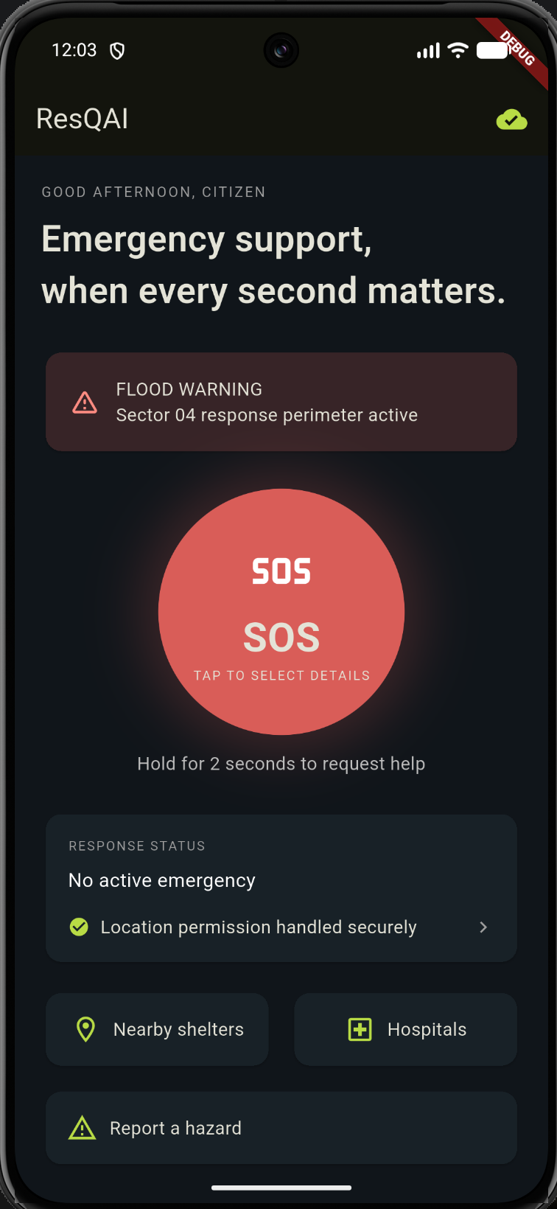
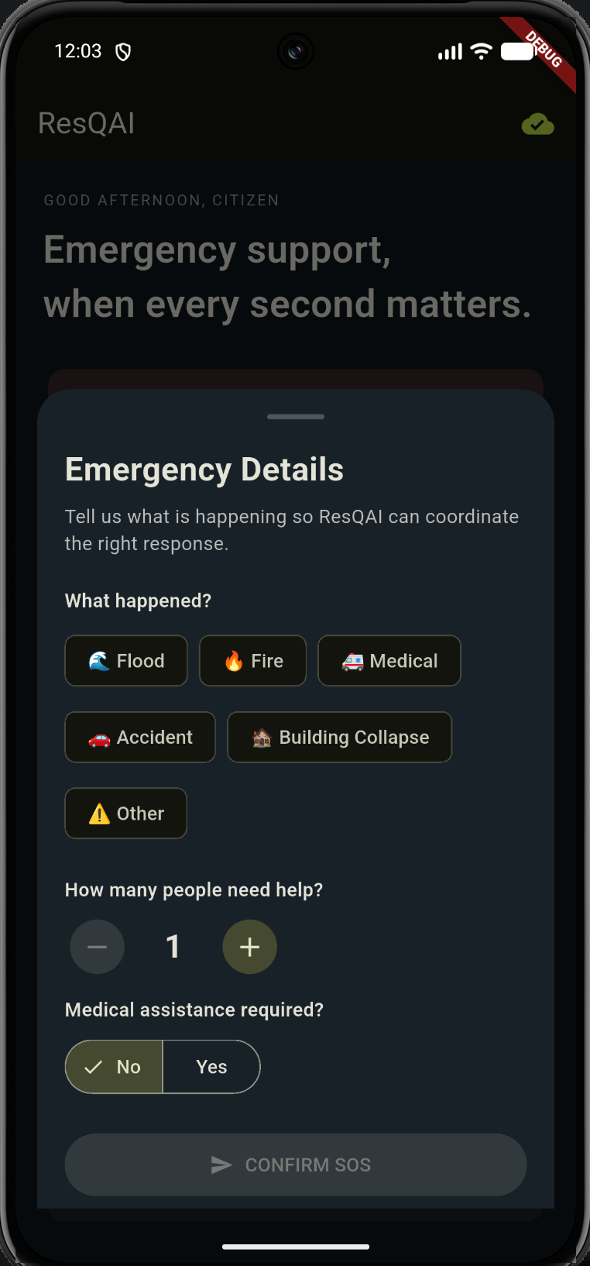
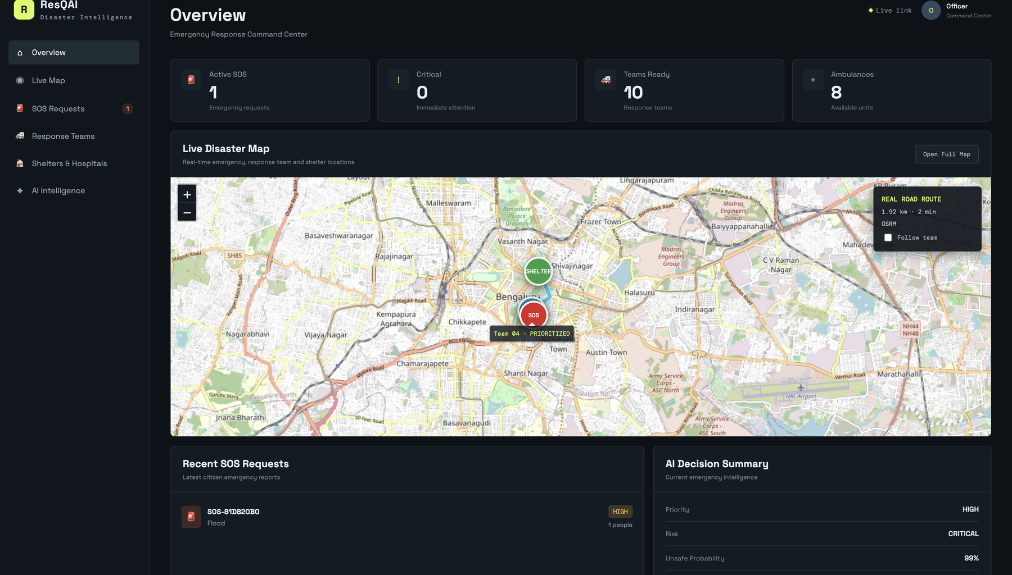
5.2 RESULTS
Home Screen
SOS Workflow – Emergency Details
Command-Center Dashboard (web prototype)
Application UI
Verified (screenshots)
Navigation
Pending
Location Functionality
Pending
Backend Integration
Prototype – to verify
End-to-End Testing
Pending
Notes:
Screenshots are the real app captures (two Flutter app screens and the web command-center dashboard), shown at their original proportions. The status chips are conservative: update them to match what you have actually tested. The dashboard figures (teams, ambulances, AI summary) should be described as prototype/demo data unless they come from live sources.

Slide 9
6. CONCLUSION AND FUTURE WORK
Conclusion
Future work
Mobile application foundation for citizen-focused disaster response
Organizes emergency workflows, location access and incident information
Modular structure supports future improvements
Reliability, privacy and clear communication are key design priorities
Resolve remaining build issues
Complete functional testing on an Android device
Add secure backend and database integration
Integrate verified emergency services where authorized
Improve maps and incident visualization
Explore multilingual and accessible interfaces
Improve offline support and reliable report delivery
Roadmap
Current Foundation
Testing
Integration
Future Improvements
Notes:
Summarise what has been built, then walk the roadmap: foundation, testing, integration, future improvements.

Slide 10

7. REFERENCES AND THANK YOU
References
1. Flutter Documentation – https://docs.flutter.dev/
2. Dart Documentation – https://dart.dev/
3. Riverpod Documentation – https://riverpod.dev/
4. Geolocator Package – https://pub.dev/packages/geolocator
5. GoRouter Package – https://pub.dev/packages/go_router
6. Dio Package – https://pub.dev/packages/dio
7. United Nations Office for Disaster Risk Reduction – https://www.undrr.org/
THANK YOU
Questions and Discussion
Notes:
References are limited to the technologies and concepts used in the deck. No papers, authors or findings have been invented.

